Slide 1
ALGORITHMIC TRADING BOT
PROJECT TEAM ID:MP23CSE141
Guide Name: Dr. Sumit Pundir
Associate Professor
KARTIKAY
AMAN PRAJAPATI
MANISH KUMAR SINGH
TANISH GUPTA
2016809
2016617
2016847
2017083

Slide 2

INTRODUCTION:
Algorithmic trading automates order execution, leveraging computer speed and predefined rules. It enhances success rates by refining strategies based on timing, value, and mathematical models, bypassing human emotions for rapid, precise trades.
The trading bot simplifies processes, enabling quick profits with minimal effort. It addresses the demand for an accessible yet efficient solution in the expanding global algorithmic trading market.

Slide 3
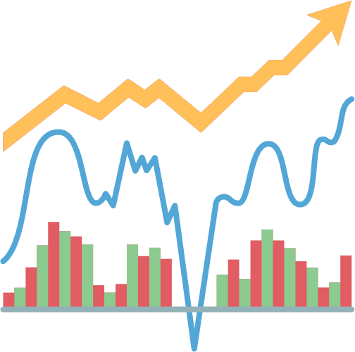
PROBLEM STATEMENT
Creating a dynamic algorithmic trading bot is key in navigating modern financial markets. Focused on agile market analysis and adaptable strategies, it optimizes for profitability and risk management, integrating fundamental and sentiment analysis to seize opportunities while minimizing risks.

Slide 4

LITERATURE SURVEY
Case Study 02
Advancements in AI and ML for Stock Market Prediction
AI and ML have significantly improved stock market prediction, addressing its complexity and dynamism.
Key Models
Linear and Logistic Regression
Linear Regression: Easy to implement but assumes linear relationships, limiting effectiveness for complex market data.
Logistic Regression: Estimates probabilities for binary outcomes, constrained by linearity assumptions.
Case Study 01

Slide 5
LITERATURE SURVEY
Key Models
2. Deep Learning Models
LSTM Networks: Excellent for sequential data and long-term dependencies, outperform traditional models but need large datasets and are computationally expensive.
3 . Ensemble Model
Random Forest: Handles large datasets, reduces overfitting but is less interpretable and resource-demanding.
XGBoost: Efficient, scalable, performs well on structured data, requires complex parameter tuning.
Case Study 02
Case Study 01

Slide 6

OBJECTIVES
Market Analysis and Strategy Development: Bot analysesmarkets, tailoring strategies for stocks, crypto, forex, and commodities in real-time
Data Acquisition and Processing: Efficiently processes vast financial data from APIs, market feeds, and news outlets.
Risk Management: Implements robust risk management with stop-loss orders, position sizing, and portfolio diversification.
Execution Speed and Efficiency: Prioritizes low-latency, high- trading for swift execution and minimal slippage.
Back-testing and Simulation: Utilizes a concise back-testing framework to optimize strategies and simulate diverse market scenarios.

Slide 7

METHODOLOGY
Model Selection: Based on the data analysis and initial testing, select the most promising models (ARIMA, LSTM, Prophet, and FinBERT) for further development and backtesting.
Strategy development:
ARIMA-Based Strategy: Trade based on forecasted price trends from the ARIMA model.
LSTM-Based Strategy: Use LSTM predictions to make informed trading decisions.

Slide 8
METHODOLOGY
Strategy development:
Sentiment-Based Strategy with FinBERT: React to market sentiment using FinBERT to trigger buy or sell signals.
ROC Strategy:The trading bot calculates the rate of change (ROC) for stocks, identifies buy signals by comparing ask prices with the last traded prices, and sends an email alert for the stock with the highest ROC and favorable price conditions.

Slide 9
METHODOLOGY
Signal Generation: Generate trading signals based on model predictions; e.g., a predicted upward trend triggers a buy signal, a downward trend triggers a sell signal.
Risk Management: Incorporate risk management techniques like stop-loss levels, take-profit targets, and position sizing to manage losses and protect profits.
Portfolio Allocation: Allocate capital across different strategies, using a diversified approach based on each strategy's expected performance and risk profile.
Continuous Monitoring: Set up a system to track each strategy's performance in real-time, including monitoring trading signals, executed trades, and overall portfolio performance.

Slide 10
METHODOLOGY
Back Testing:
Data Collection: Acquire comprehensive historical market data, ensuring cleanliness and accuracy.
Strategy Definition: Clearly define trading rules and specify parameters like moving averages and stop-loss levels.
Simulation: Execute trades on historical data according to predefined rules, simulating order handling and potential slippage.

Slide 11
METHODOLOGY
Back Testing:
Performance Metrics Calculation: Calculate total and annualized returns, evaluate risk metrics, and analyze trade statistics.
Analysis and Optimization: Analyze results, optimize parameters cautiously, and validate robustness using out-of-sample testing.

Slide 12
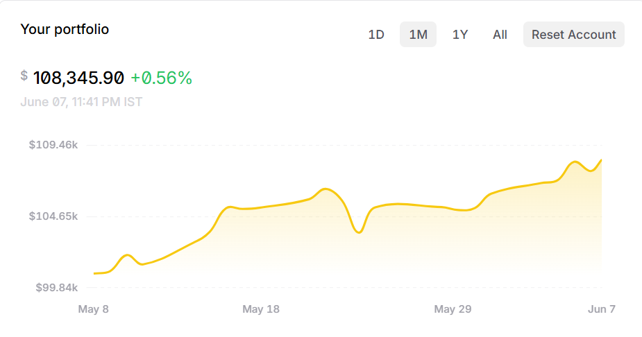
RESULTS AND DISCUSSION
THE CHART ALONGSIDE REPRESENTS THE GAINS OBTAINED BY USING THE ROC AND NLP BASED STRATEGIES FOR TRADING
ONE MONTH GAINS ARE 8.345%

Slide 13
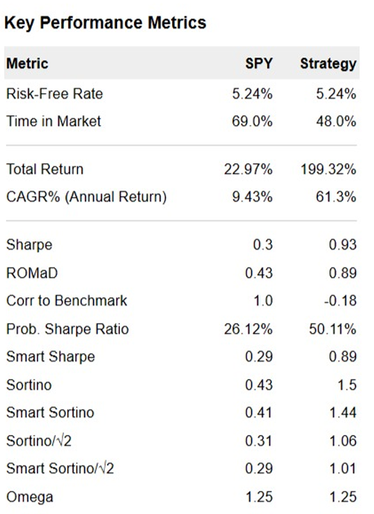
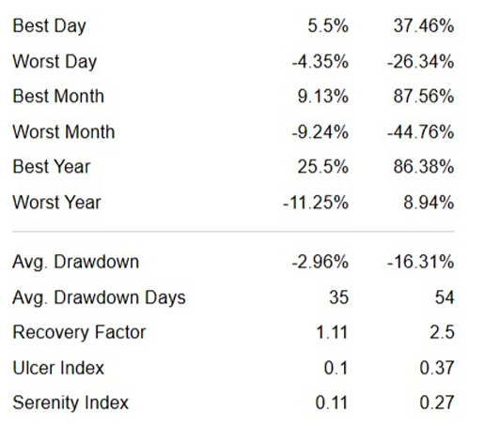
KEY PERFORMANCE INDICATORS

Slide 14
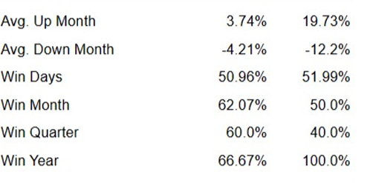
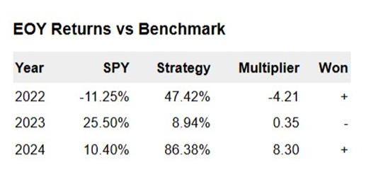
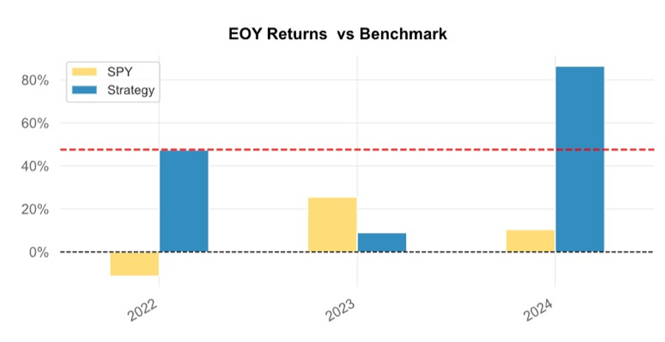
THESE RESULTS ARE PROOF THAT STRATEGY IS QUITE ROBUST AS IT WAS ABLE TO MAKE SUBSTANTIAL PROFITS IN 2022 WHEN MARKETS WERE VOLATILE AND ECONOMIES WERE RECOVERING FROM THE PANDEMIC

Slide 15
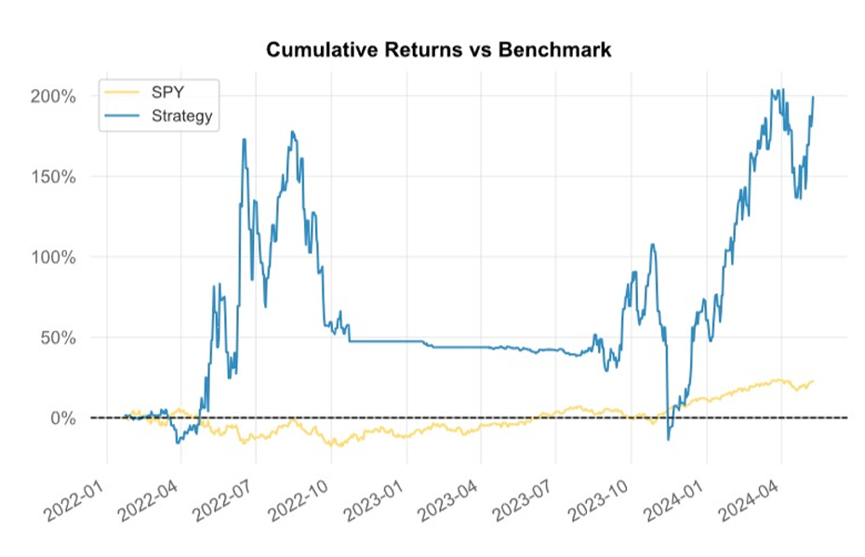
RETURNS COMPARED TO S&P 500
The graph alongside represents the cumulative return as compared to the SPDR S&P 500 ETF trust fund. SPDR is an acronym for the Standard & Poor's Depositary Receipts, the former name of the ETF. It is designed to track the S&P 500 stock market index. This fund is the largest and oldest ETF in the USA.
GRAPH BASED ON 5 YEARS OF BACKTESTING

Slide 16
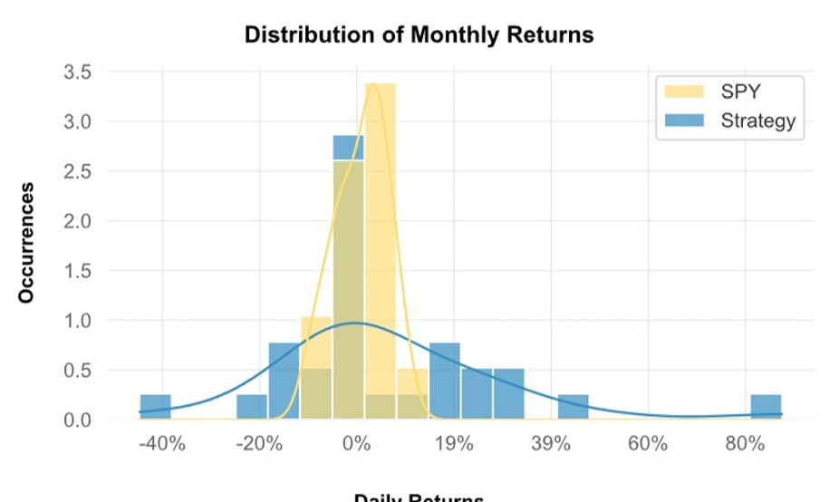
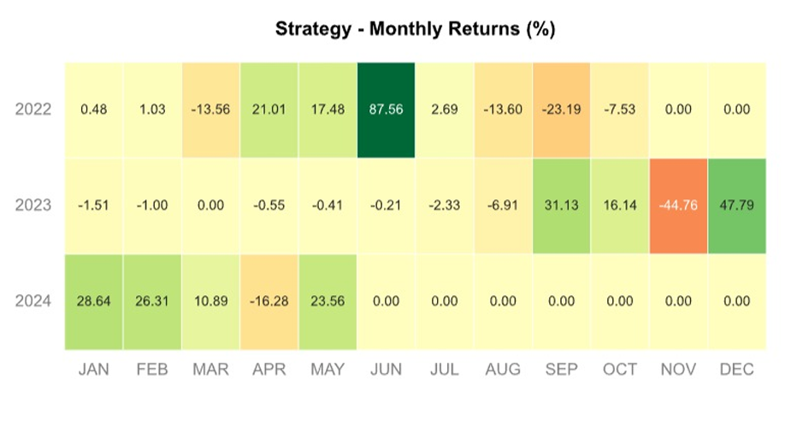
Monthly Returns Barplot
The barplot represents the monthly returns of the trading strategy. The returns kind of follow a bell shaped curve. The gains have a wide spread resulting which signifies high volatility of the NLP strategy with 100 percent cash at risk.
Heatmap
As evident from the heatmap, we can see that strategy is very volatile if 100 % of cash is at risk. Though this ultimately gives high return in future, but such risky practices should be avoided and traders should try to square off at their threshold gains

Slide 17
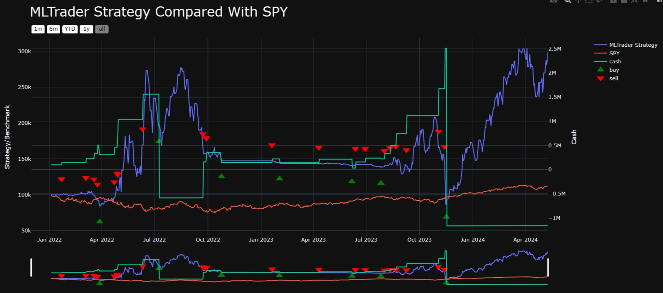
PERFORMANCE OF IMPLEMENTED STRATEGY COMPARED TO S&P 500 ETF TRUST FUND

Slide 18
CONCLUSION AND FUTURE WORK
The project successfully developed an advanced algorithmic trading bot using ARIMA, LSTM, and FinBERT models, validated through extensive backtesting and live trading simulations, demonstrating consistent returns and effective risk management. Future improvements include implementing high-frequency trading algorithms to enhance execution speed and precision, and developing a user-friendly dashboard for real-time insights and analytics, aiming to create a robust, efficient, and user-centric trading solution.

Slide 20
REFERENCES
[1] Ash Booth, Enrico Gerding, and Frank Mcgroarty. 2014. Automated trading with performance weighted random forests and seasonality. Expert Syst. Appl. 41, 8 (June ,2014), 3651± 3661. DOI: https://doi.org/10.1016/j.eswa.2013.12.009.
[2] Suryoday Basak, Saibal Kar, Snehanshu Saha, Luckyson Khaidem, Sudeepa Roy Dey, Predicting the direction of stock market prices using tree-based classifiers, The North American Journal of Economics and Finance, Volume 47, 2019, Pages 552- 567, ISSN 1062-9408,
https://doi.org/10.1016/j.najef.2018.06.013.
[3] Maragoudakis, M and Serpanos, D. (2010), towards stock market data mining using enriched random forests from textual resources and technical indicators. AIAI 2010, IFIP AICT 339, pp. 278-286. https://link.springer.com/chapter/10.1007/978-3-642-16239-8_37.
[4]Manoj Thakur and Deepak Kumar. 2018. A hybrid financial trading support system using multi-category classifiers and random forest. Appl. Soft Compute. 67, C (June 2018), 337±349. DOI: https://doi.org/10.1016/j.asoc.2018.03.006.
[5] Cain Evans, Konstantinos Pappas, Fatos Xhafa, Utilizing artificial neural networks and genetic algorithms to build an algo-trading model for intra-day foreign exchange speculation, Mathematical and Computer Modelling, Volume 58, Issues 5±6, 2013, Pages 1249-1266, ISSN 0895-7177, https://doi.org/10.1016/j.mcm.2013.02.002.

Slide 21
[6] Omer Berat Sezer, Murat Ozbayoglu, Erdogan Dogdu, A Deep Neural-Network Based Stock Trading System Based on Evolutionary Optimized Technical Analysis Parameters, Procedia Computer Science, Volume 114, 2017, Pages 473-480, ISSN 1877-0509
[7]Maragoudakis, M and Serpanos, D. (2010), towards stock market data mining using enriched random forests from textual resources and technical indicators. AIAI 2010, IFIP AICT 339, pp. 278-286.
[8] Manoj Thakur and Deepak Kumar. 2018. A hybrid financial trading support system using multi-category classifiers and random forest. Appl. Soft Comput. 67, C (June 2018), 337±349. DOI:

Slide 22
THANK YOU

